Slide 1
Intrusion detection with Neural Networks

Slide 2
Agenda
Background
Online Neural Networks, Offline Neural Networks
Intrusion detection systems
Application of Neural Networks in IDS
Model Inputs, Model formation, Epochs and Accuracy results
IDS using NN success rate

Slide 3
Background
Modern age computer systems
Need for better security standards from attacks breaches, cybersecurity incidents
Loss of information, misuse of information,
Types of intrusions in the system
Web Based Intrusion
Network Based Intrusion
Host Based Intrusion
What are Intrusion detection systems?
Types of Intrusion detection systems
Anomaly based detection - Unusual activity that could indicate an intrusion
Signature based or misuse of signature - exploit known vulnerabilities of the system

Slide 4
Why Neural Networks?
Ideally, no realistic approach to identify all attacks that can occur
Laborious process as well as challenging
Anomaly detection can raise false alarms
Unusal but legitimate use may be considered anomalous
Hence instead of general legitimate use, the behavior of individual users can be modeled that helps to identify the behavior pattern and formulate an easier way to detect anomaly.
Like – adding some more specific steps to question the end user, add some more questionnaire to answer in the steps to the access the application
Challenge is to develop model that identifies legitimate behavior that would accept novel legitimate use

Slide 5
Online and Offline IDS
IDSs also differ in whether they are on-line or off-line.
Types of IDSs
Off-line IDSs are run periodically and they detect intrusions after-the-fact based on system logs.
On-line systems are designed to detect intrusions while they are happening, thereby allowing for quicker intervention.
On-line IDSs are computationally very expensive because they require continuous monitoring. Decisions need to be made quickly with less data and therefore they are not as reliable.

Slide 6
Why Move to Offline IDS
One problem with the on-line approach is that most of the effort goes into predicting the order of commands. I the order does not matter much, but the distribution of commands that are used is revealing.
Detecting intrusion real time –
As the user is typing commands, it is difficult to identify the order of commands since it vary a lot
Distribution of command over a session or a data differs from usual

Slide 7
NNID (Neural Network Intrusion Detector)
Based on these three ideas
- Identify Users Pattern of command sequence and execution, Model the system and track the legitimate use behaviors
NNID is a backpropagation neural network trained to identify users based on what commands they use during a day. For each day if the users' sessions match their normal pattern or not, an investigation can be launched
Keeping the log of commands executed for each user and learning the user profiles from histograms
The NNID model is implemented in a UNIX environment and consists of keeping logs of the commands executed, forming command histograms for each user, and learning the users' profiles from these histograms.
Train a model by learning from the examples of patterns for legitimate use
Provide offline monitoring solution or model to identify the anomalous behavior.
Detect un expected behavior or use of the system based on previous experiences
NNID provides an elegant solution to off-line monitoring utilizing these user profiles. In a system of 10 users, NNID was 96% accurate in detecting anomalous behavior (i.e. random usage patterns), with a false alarm rate of 7%

Slide 8
Neural Network Intrusion Detection System
NNID provides an elegant solution to off-line monitoring utilizing these user profiles.
NNID is a backpropagation neural network
The NNID model is implemented in a UNIX environment and consists of keeping logs of the commands executed
is independent of the platform, system vulnerability, and type of intrusion
The NNID anomaly intrusion detection system is based on identifying a legitimate user based on the distribution of commands she or he executes
This is justifiable because different users tend to exhibit different behavior, depending on their needs of the system.

Slide 9
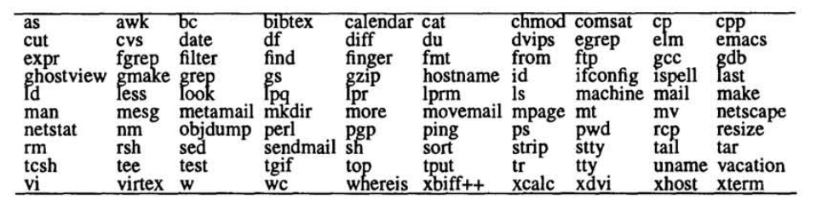
Building a NNIDS system
Building NNID for a particular computer system consists of the following three phases:
Collecting training data: Obtain the audit logs for each user for a period of several days. For each day and user, form a vector that represents how often the user executed each command.
Training: Train the neural network to identify the user based on these command distribution vectors.
Performance: Let the network identify the user for each new command distribution vector. If the network's suggestion is different from the actual user, or if the network does not have a clear suggestion, signal an anomaly
Set of 100 commands used to describe user behavior

Slide 10
Experiments
Research Lab in University of Texas with NetBSD operating systems that capture the audit trail logging for accounting
The number of users and the total number of commands executed per day are on an order of magnitude that is manageable. Thus, the feasibility of the approach could be tested with real-world data without getting into scalability issues.
The system is relatively unknown to outsiders and the users are all known to us, so that it is likely that the data collected on it consists of normal user behavior (free of intrusions).

Slide 11
Definint input vector
For each non linear interval, the command was categorized as per the frequency of its use.
First interval – for commands that were necver used
Second interval – for commands used once or twice and
Last interval – command was used more than 500 times
Intervals were presented in values 0 to 1 with 0.1 increments hence 11 intervals of input vectors
These values for one for each command were then concatenated into a 100-dimensional command distribution vector (also called user vector below)
to be used as input to the neural network.

Slide 12
Defining a “print” of a user
Idea behind NNID system-
collect statistics about the users' command usage over a period of time, such as a day
try to recognize the distribution of commands as legitimate or anomalous off-line
identifying a legitimate user based on the distribution of commands she or he execute
the frequency with which a command is used varies from user to user.

Slide 13
Defining Architecture
Standard 3 layer backpropagation architecture was chosen for the neural network.
To avoid overtraining, several training sessions were run prior to the actual experiments to see how many training cycles would give the highest performance.
Trained on 8 randomly chosen days of data (65 user vectors)
Performance tested on remaining 4 days data (24 vectors)
Epochs 30, 50, 100, 200 and 300 out of which -= 100 gave best perfromance
Four splits of the data into training and testing sets were created by randomly picking 8 days for training.

Slide 14
Resulting 4 networks tested in 2 tasks –
User identification with the NNID Network.
4* 8 – 24 test vectors in one of the 4 splits tested.
Output units are lined up from left to right, activations are represented by size of squares.
2 false always – where activation – 0.01 and another with 0,35
Other test vectos are identified with activation higher than 0.5

Slide 15
Results
Out of 24 legitimate user vectors, the network identified 22. Most of the time the correct output unit is very highly activated, indicating high certainty of identification. However, the activation of the highest unit was below 0.5 for two of the inputs, resulting in a false alarm.
Interestingly, in all false alarms in all splits, the falsely-accused user was always the same. A closer look at the data set revealed that there were only 3 days of data on this user.
No matter how much data one collects, there may still not be enough for some extremely infrequent user. Therefore, we believe the results obtained in this rather small data set give a realistic picture of the performance of the NNID system.

Slide 16
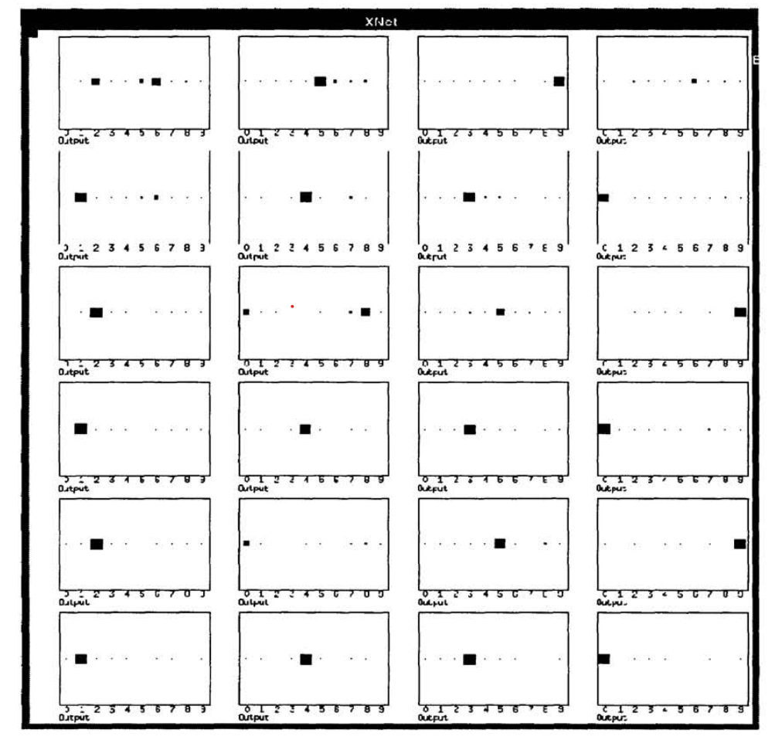
User identification with the NNID Network

Slide 17
Conclusion
Experimental evaluation on real-world data shows that NNID can learn to identify users simply by what commands they use and how often, and such an identification can be used to detect intrusions in a network computer system. The order of commands does not need to be taken into account. NNID is easy to train and inexpensive to run because it operates off-line on daily logs. As long as real-time detection is not required, NNID constitutes a promising, practical approach to anomaly intrusion detection

